Slide 1
Python Project
Pomodoro Timer Application
Presentation By: Ria Sangwan

Slide 2
Overview
Pomodoro Timer is a Python-based time management application.
It follows the Pomodoro Technique.
Helps users stay focused by dividing work into timed sessions.
Includes work sessions and short breaks.

Slide 3
Problem Statement
Many People struggle with time management and distractions.
Working continuously for long hours reduces productivity.
There is a need for a simple tool to manage focused work sessions.
Solution: Develop a Pomodoro Timer using Python to improve productivity

Slide 4
Objectives
Implement the Pomodoro Technique using Python.
Help users manage time effectively.
Improve focus and reduce burnout.
Practice Python programming concepts.

Slide 5
Pomodoro Technique
Work for 25 minutes (Focus Session)
Take a 5-minutes break
After 4 sessions, take a long break.
Repeat the cycle

Slide 6
Technologies Used
Programming Language: Python
Libraries/Concepts:
Time Module
Loops
Functions
Conditional Statements, Basic UI (Tkinter used)

Slide 7
Application Workflow
User starts the timer
Focus session begins
Countdown timer runs
Break session starts automatically
Cycle repeats until stopped

Slide 8
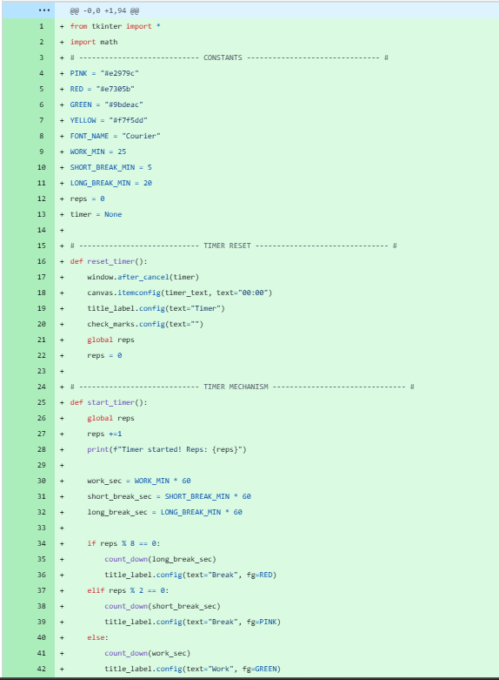
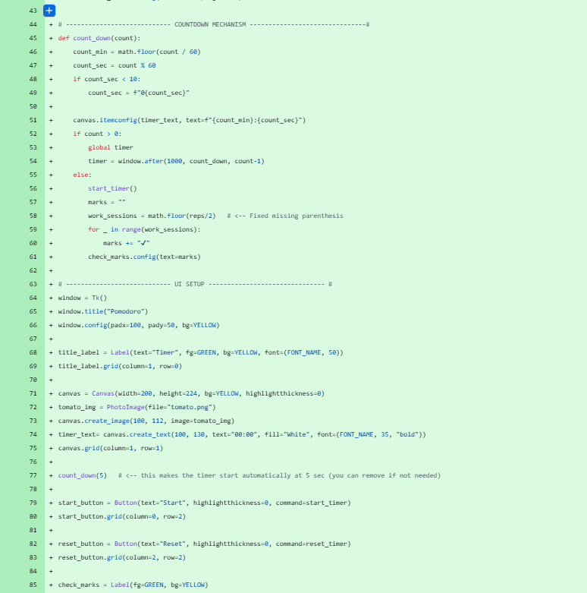
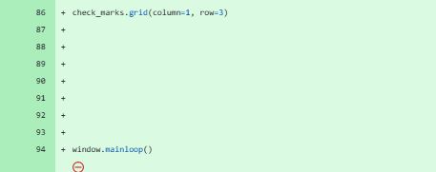
Code Snippet

Slide 9
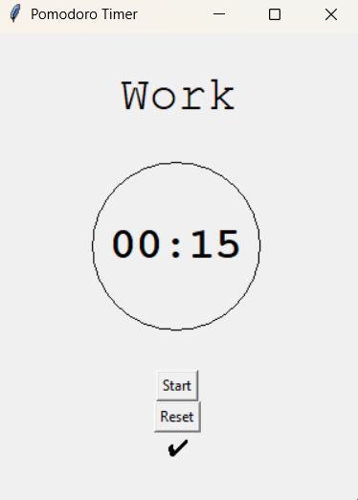
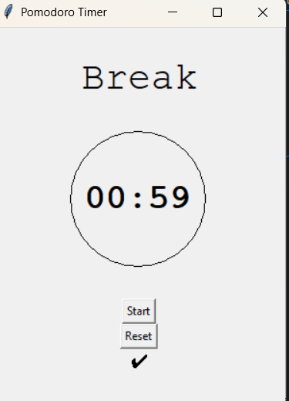
Output/Features
Displays countdown timer
Automatically switches between work and break sessions.
Improves focus and productivity
Simple and user-friendly

Slide 10
Key Learnings
Challenges Faced
Accurate timer implementation
Managing sessions transitions
Keeping the program responsive
Understanding time-based programs in Python.
Working with time.sleep()
Writing reusable functions
Improving logical flow using loops

Slide 11
Future Enhancements
Add GUI using Tkinter.
Sound notifications for session end
Customizable session duration
Progress Tracking

Slide 12
GitHub Repository
Complete source code available on GitHub. Github Repo
Easy to run and modify
Beginner-friendly implementation

Slide 13
Conclusion
Pomodoro Timer is a practical Python project.
Demonstrates real-world use of python
Helps improve productivity using proven technique

